Slide 1
SENTIMENT ANALYSIS OF COVID-19 TWEETS AND VISUALIZATION DASHBOARD
PROJECT BY TEAM ACES

Slide 2
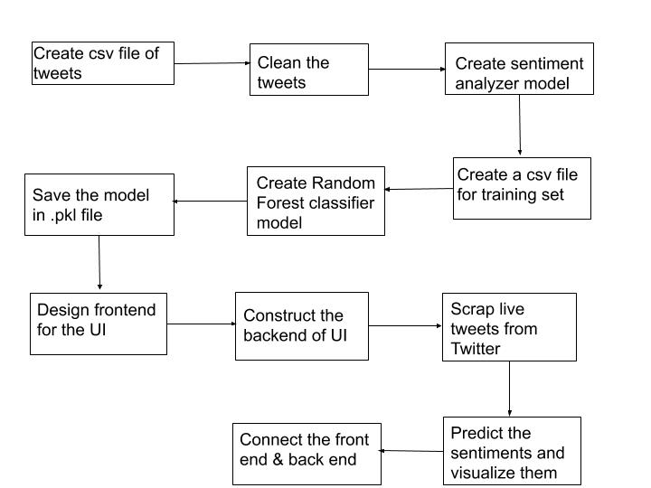
PROJECT FLOW DIAGRAM

Slide 3
DATA EXTRACTION AND PREPROCESSING
Extracted using Twitter API & Tweepy library, stored in a csv file using the csv writer and then converted into a dataframe
Clipped tweets are removed and then remaining tweets made free from punctuation, URLS, stop words and then lemmatized using the re, string and nltk libraries

Slide 4
CREATION OF SENTIMENT ANALYSIS MODEL AND TRAINING SET FOR CLASSIFIER
The cleaned and lemmatized tweets considered for making the Sentiment Analysis model using the nltk Sentiment Intensity Analyzer
Based on the compound scores of the tweets, classified into positive, negative & neutral tweets.
This complete data frame along with the analyzed sentiment converted into a csv file which acts as a training set for the classifier built in next step

Slide 5
CREATION OF CLASSIFICATION MODEL AND .pkl FILE
The cleaned tweets along with their sentiments loaded in a data frame
The data then vectorized using the sklearn TfidVectorizer
A Random Forest classifier built using the sklearn.ensemble.RandomForestClassifier
The model then trained on the vectorized data to predict the sentiments of tweets without using the sentiment analyzer model
This model is saved in a .pkl file using the pickle library

Slide 6
CREATING FRONT END PART OF THE UI
Basic HTML is used to create the home page and result page of the User Interface
CSS is then used to make the UI look more attractive
Home page - Description, Search box to search tweets of any topic
Result page - Pie chart of sentiments (Google Charts), few scrapped tweets with their sentiments

Slide 7
CREATING BACK END PART OF THE UI
Flask library of python is used to construct the back end of the User Interface
Uses the classifier model saved as a .pkl file to predict the sentiments of the live tweets scrapped
The scrapping of live tweets made possible by using Twitter API calls in the flask file as well
Privilege to scrap tweets related to any topic & any number of topics

Slide 8
CONNECTING THE BACK END AND FRONT END
The back end & front end part of the User Interface are integrated together using the .route() function

Slide 9
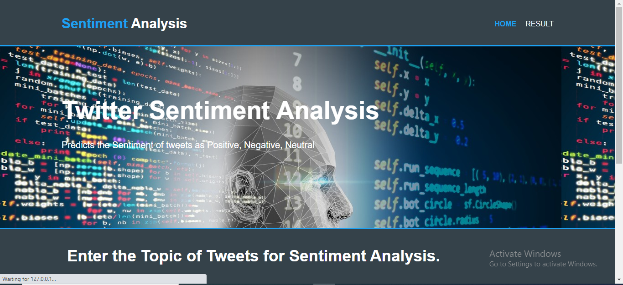
HOME PAGE OF THE UI

Slide 10
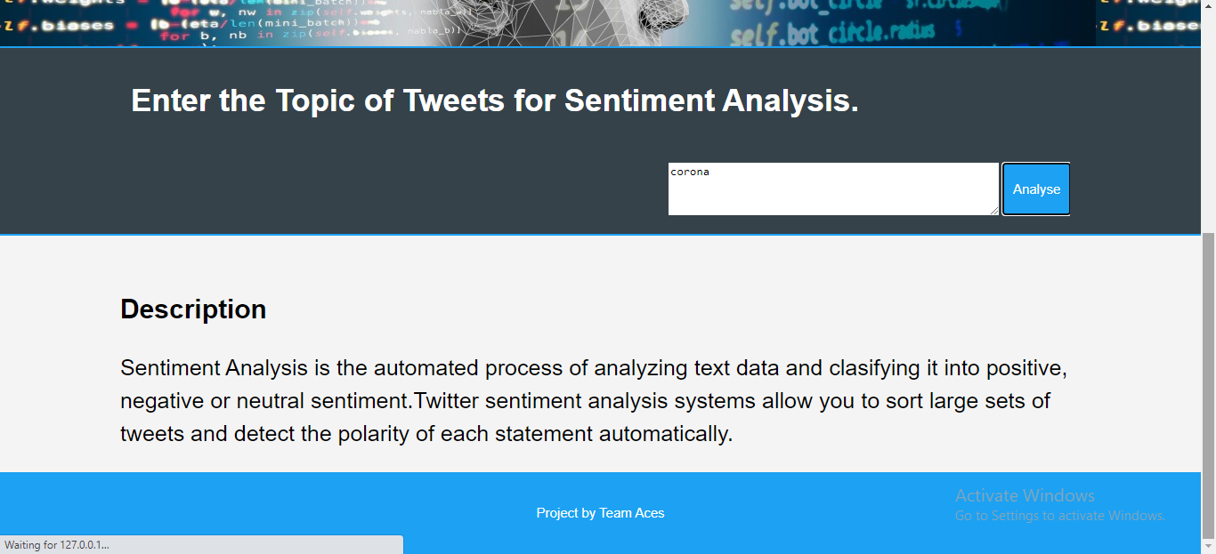
HOME PAGE (CONTD.)

Slide 11
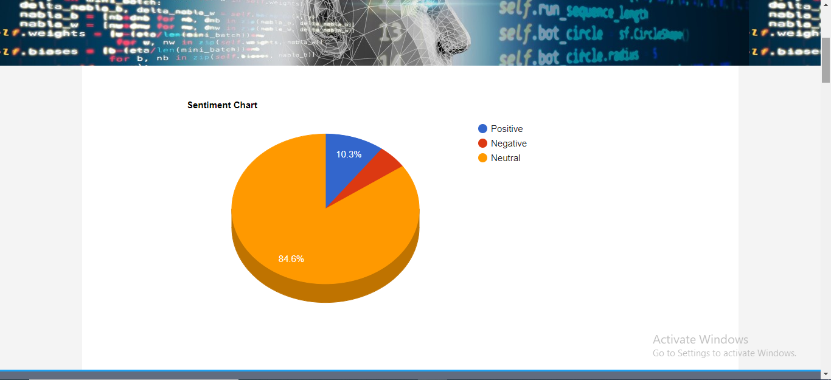
RESULT PAGE OF THE UI

Slide 12
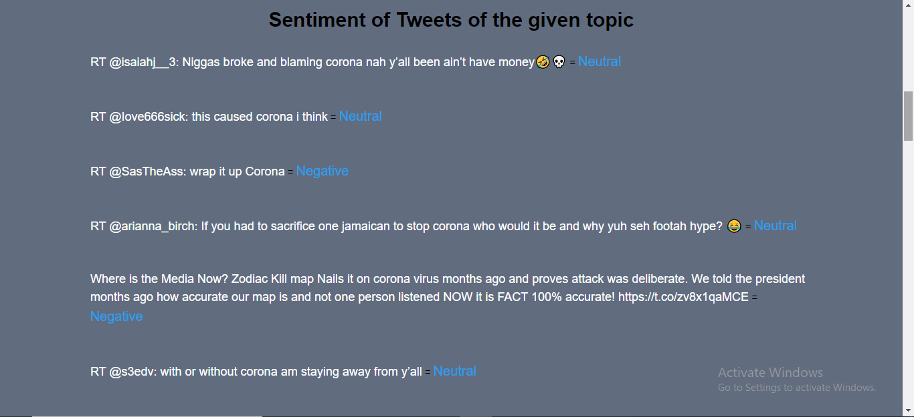
RESULT PAGE (CONTD.)

Slide 13
FINAL DELIVERABLES
Sentiment Analysis model (nltk Sentiment Intensity Analyzer)
Sentiment Prediction model (sklearn Random Forest Classifier)
UI to search tweets related to any topic & any number of topics & predict their sentiments with a pie chart as visualization

Slide 14
THANK YOU
PROJECT BY TEAM ACES

